Slide 1
Galaxy S24 series Customer Consultant Guide
Customer Consultant / Online FAQ reference Guide
Version 1.1
HQ MX Quality Administration Group
18th January 2024
Region : Global
Language : English

Slide 2
Notice
Notice:
All functions, features, specifications and other product information provided in this document including,
but not limited to, the benefits, design, pricing, components, performance, availability, and capabilities of
the product are subject to change without notice or obligation. Samsung reserves the right to make changes
to this document and the product described herein, at anytime, without obligation on Samsung to provide notification of such change.
Please see the end of this guide for Version History details
This document is for distribution to only those noted in the distribution guide provided on the title slide of this document.
Where status of " WEB FAQ / How to guide creation for support websites is “No”, any unauthorized distribution by any party notified of this document outside of stated intended recipients noted in the distribution status guide may result in legal action being taken by Samsung in compliance with local law.
This material contained in this document is intended for use “with / as” | Status
Samsung Customer Contact Centres | Yes
Network Operator Contact Centres | No
WEB FAQ / How to guide creation for Samsung.com sites | Yes
Samsung Authorised Service centres (ASC) | Yes
Please note: Although many contents of this document may be suitable for WEB guide creation, it is not to be posted on the internet download in its entirety as a download item. And recommended not to use some sensitive contents of this document for WEB.

Slide 3
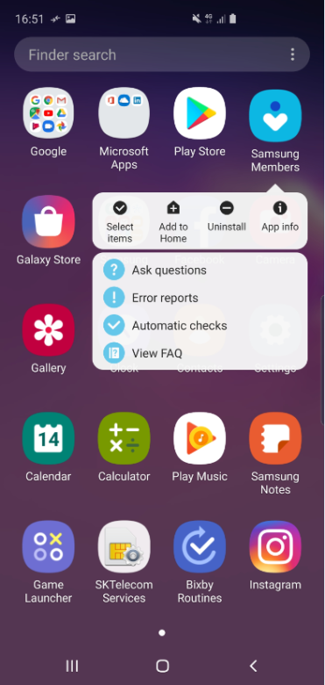
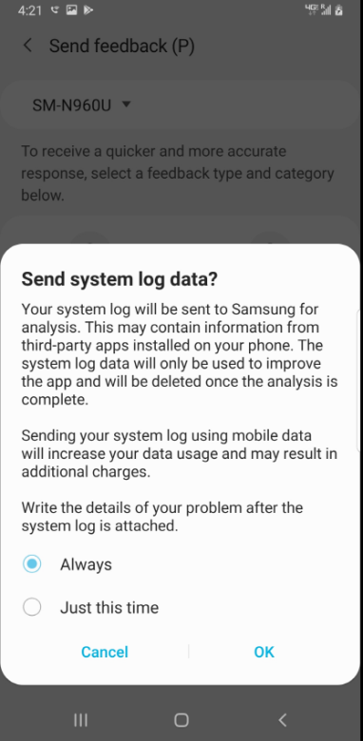
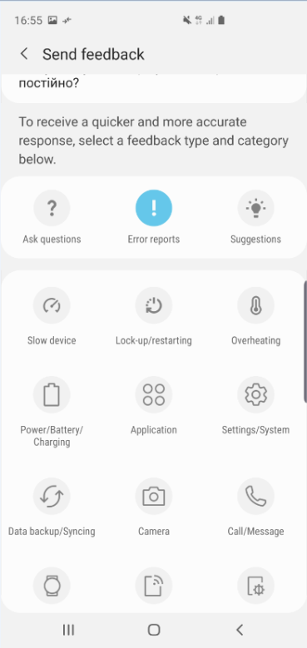
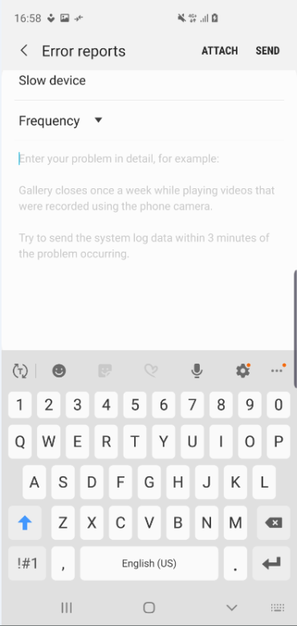
Advice
*Customer Life/Property/Identity Theft issues should follow the dedicated immediate report process for this not common consulting process
If you couldn’t give to customers any solution based on this guide or your basic information while consulting, please advise to users to register Log file through Samsung Members.(If Samsung Members is not pre-installed on device, user need to install the application firstly ) Then, HQ MX CS team and relevant teams will search for solution and reply to users. Samsung is committed to providing the best possible mobile experience to customers.
[ How to report error using Samsung Members application ]
1. Touch and hold Samsung Members icon on Apps screen and Tap Error reports
2. Tap OK on agreement popup for sending system log data
3. Select Symptom category
4. Describe problem in detail and SEND.

Slide 4
Specifications
Updated at 2024.1.18
 |  | Galaxy S24 Ultra | Galaxy S24+ | Galaxy S24
Display | Main | 6.8” Dynamic AMOLED 2X QHD+ (3120 x 1440) 1-120Hz, S Pen support | 6.7” Dynamic AMOLED 2X QHD+ (3120 x 1440) 1-120Hz | 6.2” Dynamic AMOLED 2X FHD+ (2340 x 1080) 1-120Hz
Rear Camera | Ultra Wide | 12 MP F2.2 | 12 MP F2.2 | 12 MP F2.2
 | Wide | 200MP OIS F1.7, Adaptive Pixel Optical quality 2x | 50MP OIS F1.8, Adaptive Pixel Optical quality 2x | 50MP OIS F1.8, Adaptive Pixel Optical quality 2x
 | Tele1 | 50MP OIS F3.4, 5x optical zoom, Optical quality 10x | 10MP OIS F2.4, 3x optical zoom | 10MP OIS F2.4, 3x optical zoom
 | Tele2 | 10MP OIS F2.4, 3x optical zoom | - | -
 | Depth | Laser AF sensor | - | -
Front Camera |  | 12MP F2.2 | 12MP F2.2 | 12MP F2.2
Performance |  | Snapdragon 8 Gen 3 for Galaxy (4nm) | Snapdragon 8 Gen 3 for Galaxy/ Exynos2400 for Galaxy (4nm) | Snapdragon 8 Gen 3 for Galaxy/ Exynos2400 for Galaxy (4nm)
 |  | Memory: 12 GB Storage: 256/512 GB, 1 TB | Memory: 12 GB Storage: 256/512 GB | Memory: 8 GB Storage: 128/256/512 GB
Battery(Typical) |  | 5,000mAh Wire/Wireless Charging Wireless PowerShare | 4,900mAh Wire/Wireless Charging Wireless PowerShare | 4,000mAh Wire/Wireless Charging Wireless PowerShare
※ Some of specific option or availability may vary by model code, region or country, carrier and SW version

Slide 5
FAQ
FAQ

Slide 6
What are the color options?
Updated at 2024.1.18
Q: What are the color options?
A:
(S24/S24+) : Onyx Black, Marble Gray, Cobalt Violet, Amber Yellow
(S24 Ultra) : Titanium Black, Titanium Gray, Titanium Violet, Titanium Yellow
[Samsung.com Exclusive] (S24/S24+) : Jade Green, Sandstone Orange, Sapphire Blue / (S24 Ultra) : Titanium Green, Titanium Orange, Titanium Blue
Hero Color : Titanium Gray(S24 Ultra), Cobalt Violet(S24+) , Amber Yellow(S24)

Slide 7
Why did S24 Ultra screen type change from edge to flat screen?
Updated at 2024.1.18
Q: Why did S24 Ultra screen type change from edge to flat screen?
A: The Ultra's extrude design, which has continued from note design, has the following advantages
- Even though it is a large-screen device, it provides a stable grip by applying a curvature on both sides
- Even though it is a thick device, it's curved line provides slim look
- Has advantage in pen storage
However, in the case of Ultra, the model emphasizes productivity based on our own S-pen use.
Users have come up with VOCs for improving pen usability, and so, from S23 Ultra, we have been designing to flatten the curved surface and enhance pen usability.
Especially for S24 Ultra, while applying a complete Flat display to enhance pen usability, we maintain the design strengths mentioned above by applying the extrude design.
In addition, even bezel is applied to Ultra model for the first time, strengthening the clean impression from the front design.

Slide 8
What is the material of the frame?
Updated at 2024.1.18
Q: What is the material of the frame?
A:
1. S24/S24+
- Armor Aluminum, 10% higher yield strength and hardness
2. S24 Ultra
- Titanium, Higher corrosion resistance, yield strength, and hardness

Slide 9
What kind of gorilla glass is used for front and back design?
Updated at 2024.1.18
Q: What kind of gorilla glass is used for front and back design?
A: Gorilla Glass Victus 2

Slide 10
What are the improvements in HBM, Peak Luminance?
Updated at 2024.1.18
Q: What are the improvements in HBM, Peak Luminance?
A:
- S24/S24+/S24 Ultra : Peak Brightness 1,750nit → 2,600nit
- S24/S24+/S24 Ultra : HBM 1,200nit → 1,500nit

Slide 11
Is HDR10+ supported?
Updated at 2024.1.18
Q: Is HDR10+ supported?
A: Yes. It is supported.

Slide 12
Is LTPO display technique applied in all 3 models?
Updated at 2024.1.18
Q: Is LTPO display technique applied in all 3 models?
A: Yes. It is applied in all 3 models.

Slide 13
What is the range of the adaptive refresh rate?
Updated at 2024.1.18
Q: What is the range of the adaptive refresh rate?
A: All 3 models 1 ~ 120Hz supported.

Slide 14
Does the Plus/Basic model have a ToF camera?
Updated at 2024.1.18
Q: Does the Plus/Basic model have a ToF camera?
A: ToF (Time of Flight) is not supported, but by using technology, the using experience is same (for example : 3D Scanner unsupported → can measure in 2D using Quick Measure AR Core app)
- For S24 Ultra, just like S23 Ultra, ToF function is supported by Laser AF equipment (S24/S24+ Laser AF is not supported)

Slide 15
What is Instant Slow-mo?
Updated at 2024.1.18
Q: What is Instant Slow-mo?
A: User can watch the video in slow motion and more details while tapping and holding the video screen.
- 1/4x Slow motion viewing experience through AI generated intermediate frames
- Support video : HD 24fps ~ UHD 60fps
- Slow motion video Support : FHD 240fps (1/8x) → 1/32x, UHD 120fps (1/4x) → 1/16x

Slide 16
Is UWB(Ultra Wide Band) supported?
Updated at 2024.1.18
Q: Is UWB(Ultra Wide Band) supported?
A: S24+/S24 Ultra only supported (S24 Basic model is not supported)

Slide 17
What improvements are has been made about Quick Share?
Updated at 2024.1.18
Q: What improvements are has been made about Quick Share?
A: By integrating with Nearby Share, Quick Share support devices will be expanded to third-party Android devices.

Slide 18
[Link to Windows] What is Audio Streaming?
Updated at 2024.1.18
Q: What is Audio Streaming?
A: When the user’s phone and PC are connected by Link to Windows/Phone Link and the Phone app is running on the PC, the user can choose to listen to audio on apps either on the phone or the PC.

Slide 19
[Link to Windows] What is Instant Hotspot?
Updated at 2024.1.18
Q: What is Instant Hotspot?
A: PC's Wi-Fi list shows a phone connected through Link to Windows, and when the customers attempt to connect, their phone's Hotspot turns on and connects.
※ Enable users to use Mobile Hotspot without touching the phone

Slide 20
[Link to Windows] What is Open in desktop browser?
Updated at 2024.1.18
Q: What is Open in desktop browser?
A:
- Possible to check the most recent 3 tabs viewed on Samsung Internet on the user’s phone in Recent Apps
- Possible to carry on desired operation by checking webpage information (Recent Websites)

Slide 21
What is Multi Control?
Updated at 2024.1.18
Q: What is Multi Control?
A:
- Multi Control is a feature to control tablet or phone device with keyboard/mouse of Galaxy Book/Galaxy Tab
- Multi Control can also be used to copy&paste, file Drag&Drop between linked devices

Slide 22
What is App cast?
Updated at 2024.1.18
Q: What is App cast?
A:
- App cast is a feature that allows the user to multitask freely even while mirroring the screen through Smart View
- By operating App cast from menu while mirroring(Smart View), the user can use other apps freely on the phone while maintaining the mirrored screen

Slide 23
[Use Phone as TV Keyboard] What features are used by linking the device to TV?
Updated at 2024.1.18
Q: What features are used by linking the device to TV?
A: This feature is for using nearby phone device as a TV keyboard.
When TV keyboard input is needed, notification will automatically appear on the mobile and the user can start and use keyboard in SmartThings by this notification.
※ Must register Samsung TV 2022, 2023 products to SmartThings, Support availability can differ depending on TV apps

Slide 24
[About AI function] What is the AI function update plan for other models? What is the plan for further expansion of AI function support language / country?
Updated at 2024.1.18
Q: What is the AI function update plan for other models? / What is the plan for further expansion of AI function support language / country?
A: The latest flagship models before S24 series such as S23 series (including FE model), Fold5, Flip5 will be updated with AI functions.
- Language support may vary by features and expansion is under review

Slide 25
[About AI function] Does AI function learn based on users' data? (concerning about security Issue)
Updated at 2024.1.18
Q: Does AI function learn based on users' data? (concerning about security Issue)
A: Samsung/Google LLM does not learn based on customer's data.

Slide 26
[About AI function] What is Circle to Search with Google? In which countries are Circle to Search with Google supported?
Updated at 2024.1.18
Q: What is Circle to Search with Google? In which countries are Circle to Search with Google supported?
A: Circle to Search with Google is a differentiated experience jointly developed by Samsung and Google, the No.1 search company, with a strategic partnership.
Most customers want to search because they feel the need for search while watching social media or multimedia. At this time, without having to come up with the accurate search word, You can easily search by selecting the target you want to search directly from the screen.
Compared to simple Gen.AI-based visual search, Circle to Search with Google can provide advanced and rich search results, and provide natural search for additional questions with follow-up questions as if talking by understanding the search context
- Providing key information on shopping/travel, etc. and supporting continuous search, supporting 7 Locale languages for over 120 countries - EN(US), IN(Hindi), PT(BR), ES(MX), JP, KR, ID
※ Note: Because of the nature of the search algorithm, searching for the same image can yield different results.
※ Some of specific option or availability may vary by model code, region or country, carrier and SW version

Slide 27
[About AI function] How do I start the Circle to Search with Google function?
Updated at 2024.1.18
Q: How do I start the Circle to Search with Google function?
A: When you press and hold the home button on the navigation bar at the bottom of the screen, you can enter the circle gesturable screen.

Slide 28
[About AI function] Is Circle to Search with Google supported on all applications?
Updated at 2024.1.18
Q: Is Circle to Search with Google supported on all applications?
A: Circle to Search with Google does not work in apps that prohibit screen capture because of security or copyright issues (For example, Netflix/some financial apps)

Slide 29
[About AI function] What is Auto format in Samsung Notes?
Updated at 2024.1.18
Q: What is Auto format in Samsung Notes?
A: While keeping the original text, title/ paragraph classification/ paragraph and sentence position adjustment/ spelling correction are added for easy viewing and automatic organization.

Slide 30
[About AI function] In the case of meetings held in different languages, does the function recognize various languages when recording?
Updated at 2024.1.18
Q: In the case of meetings held in different languages, does the function recognize various languages when recording?
A: The users can select language, and the function only recognizes selected language.

Slide 31
[About AI function] Can I set a male/female voice for simultaneous interpretation? Also, can I sample and use my voice?
Updated at 2024.1.18
Q: Can I set a male/female voice for simultaneous interpretation? Also, can I sample and use my voice?
A: Voice change is possible, but not voice sampling.
(Currently, there are 5 types of calling party voices and 1 type of interpreted voice that is delivered to the other party,
※ However, types of voice sent/delivered differ by language)
※ Some of specific option or availability may vary by model code, region or country, carrier and SW version

Slide 32
[About AI function] Can I check how the translation was done during simultaneous interpretation?
Updated at 2024.1.18
Q: Can I check how the translation was done during simultaneous interpretation?
A: You can check the translation on the screen.

Slide 33
[About AI function] How many tones are supported in Tone Changing?
Updated at 2024.1.18
Q: How many tones are supported in Tone Changing?
A:
- 5 tones : Professional / Casual / Social Post / Polite / Emojify

Slide 34
[About AI function] What are the main AI features in Gallery?
Updated at 2024.1.18
Q: What are the main AI features in Gallery?
A: There are two main AI edit experience in S24 series's Gallery.
① Generative edit : Background expansion & Object resizing/deleting based on generative AI in Photo editor
② Edit Suggestion : Instant editing experience through proper editing feature suggestion based on viewing content analysis

Slide 35
[About AI function] What is Generative Edit?
Updated at 2024.1.18
Q: What is Generative Edit?
A: Generative Edit is a new feature based on generative AI and includes 2 editing elements.
① Fill empty background such as corners or outskirt of background when straighten or zoom out photo
② Resize / delete objects in photos and fill the empty area where the objects were existed
To enable this feature,
User need to touch blue-circle button which is in lower-left side of photo editor's first screen.
Then user can expand background and relocate the objects in photo.
And for these generated images, visible watermark will be marked in lower-left side of the generated image.

Slide 36
[About AI function] What is Edit Suggestion?
Updated at 2024.1.18
Q: What is Edit Suggestion?
A:
1. Provide integrated entry point
- Improve accessibility for multiple functions, such as Remaster, Portrait effect, Erase reflections/shadows, Remove moire, etc. to be used in one place
2. Provide context-appropriate editing function
- Suggest applicable features by photo/video
Photo : Add Portrait Effect (for portrait photos),
Background blur (In case of capturing through Portrait mode)
Long exposure(New, for motion photos),
Erase shadows/reflections, Remove Moire (In case of detecting shadow, reflection, moire in photos)
Colorize (in case of gray scaled photos)
Remaster
Highlights (provides clip for large movement)
Super slow-mo (provides clip with forward, reverse, forward & reverse effect)
GIF : Remaster (Always)
Video : Highlight Video (If there is a highlight video in suggestion),
Super Slow Motion Effect (for Super Slow-mo videos, supports Forward/Reverse/Forward & Reverse)
Star trail(for 300x Hyperlapse videos),
Long exposure(for ~FHD, ~30s videos)

Slide 37
Can previously sold S pens be used with S24 Ultra?
Updated at 2024.1.18
Q: Can previously sold S pens be used with S24 Ultra?
A:
- S23U/S22U built-in S Pen or Tablet Pen : Writing possible
- Pen for Foldable models (Fold3/Fold4) : Writing and Air Actions not possible
- S Pen Pro
When switching to S Pen : Writing and Air Actions possible
When switching to Z Fold : Writing not possible
- S Pen Creator Edition

Slide 38
Can S24 Ultra S Pen be used with other devices? What is the maximum supported distance?
Updated at 2024.1.18
Q: Can S24 Ultra S Pen be used with other devices? What is the maximum supported distance?
A: The S24 Ultra S Pen is for the S24 Ultra only. The Air Action feature cannot be used since Bluetooth pairing with models other than the S24 Ultra is not possible.
However, it can be used for "Writing" on other devices with Wacom panel applied (excluding Foldable models).
Although it is technically compatible, because of end-tip shape and color difference, cross-usage may lead to exterior quality degradation and is not recommended
- Maximum supported distance : 10m (Same as S23U)

Slide 39
Does the S Pen support water and dust resistance? Is it possible to charge and use when slightly wet?
Updated at 2024.1.18
Q: Does the S Pen support water and dust resistance? Is it possible to charge and use when slightly wet?
A: IPx5/x8 water resistance, and IP6x dust resistance is supported.
The presence of small amount of water does not cause an issue with charging and usage, but it is recommended to remove the water before using.

Slide 40
Does the S24 Ultra S Pen have an internal battery? How is it charged and what is the available usage time when fully charged?
Updated at 2024.1.18
Q: Does the S24 Ultra S Pen have an internal battery? How is it charged and what is the available usage time when fully charged?
A:
- Internal Battery: 0.35mAh embedded
- Charging Method : Charge by inserting S Pen into the device (Charging Time 7 min.)
- Air action can be used for 30 continuous minutes, with 24 hours of standby time (Same as S23U)
* May vary depending on usage environment

Slide 41
What is improved about the Notes experience?
Updated at 2024.1.18
Q: What is improved about the Notes experience?
A:
1. Handwriting Correction
- Handwriting baseline and word equal interval correction, line equal interval correction, handwriting stick-out correction can be added
2. Auto Formatting
- Organize efficiently with optimized format based on contents-type (memo, schedule, minutes)
Writing method: Text/Handwriting
3. Cover Page Creation
- Create cover page with title and summary of the note content by analyzing the note and classifying the category

Slide 42
What are new and improved points in the APS lineup compared to the previous model?
Updated at 2024.1.18
Q: What are new and improved points in the APS lineup compared to the previous model?
A:
1. Standing Grip Case
- Design : New design that provides not only a grip but also a standing function (S23 case grip function only)
- Grip : Provides a grip of soft silicone material
- Eco-friendly: 50% recycled PCM PC material applied (S23 case 20% PCM)
2. Smart View Wallet Case
- Eco-friendly: 50% recycled PCM PC material applied (S23 case 20% PCM), 20% BIO TPU (Corn Based)
3. Silicone Case
- Protection : Enhanced durability by reinforcing the thickness of the left and right side walls
- Eco-friendly: 50% recycled PCM PC material applied (S23 case 20% PCM), 20% BIO TPU (Corn Based)
4. Clear Gadget Case
- Design : Slim design with push-type gadget grip
- Eco-friendly: 50% recycled PCM PC material applied (S23 case 20% PCM), 100% recycled PET (Strap) / 50% BIO TPU (Side button)
5. Suit Case (New)
- Design : Automatically sync the lock screen & AOD
- Customization : Customize your phone to suit your style with various Interactive Cards
- Open Eco System : Compatible with various SMAPP Collaboration Cards
6. Anti-Reflecting Screen Protector (New)
- Enhanced Visibility: A clear screen even in outdoor environments with strong sunlight or under bright lighting
- Screen Protection: Anti-scratching, dust and fingerprint in everyday life
- Galaxy optimized: Ultrasonic-Fingerprint Available

Slide 43
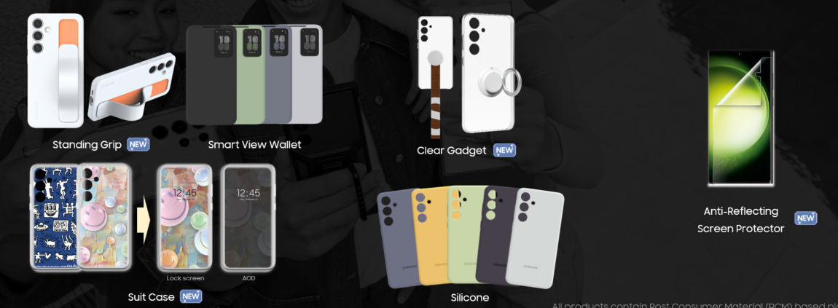
What are the dedicated case types?
Updated at 2024.1.18
Q: What are the dedicated case types?
A:
1) S24 series Cases
- Standing Grip Case
- Smart View Wallet Case
- Slicone Case
- Clear Gadget Case
- Suit Case
2) AR Screen protector

Slide 44
[About ‘Reset with previous screen lock’ feature] (1/6)
Updated at 2024.1.18
Q1) What is Reset with previous screen lock feature? How can I use it? Q2) I forgot 3P(PIN, Password, Pattern) information which is newly set for the screen lock. How can I unlock the device?
A: When you lost your current 3P(PIN, Password, Pattern) which is newly set for screen lock, you can use previously set 3P(PIN, Password, Pattern) information to unlock the device in case of being set new 3P(PIN, Password, Pattern) within 72 hour on the device installed with One UI 6.1 SW version.
If you have tried and failed 5 times when entering 3P(PIN, Password, Pattern) information you remember or anything, there will be shown with ‘Reset with previous screen lock’ menu on the lock screen, then you can use previously set 3P(PIN, Password, Pattern) within 72 hours after being set with new 3P(PIN, Password, Pattern).
And there will be provided the menu screen to set with new 3P(PIN, Password, Pattern).
This feature can only be available within 72 hours after new 3P(PIN, Password, Pattern) is set on the device, and if screen lock is set only with Biometrics type (not set for 3P type), the feature can’t be used.
[Preconditions to use]
- New 3P(PIN, Password, Pattern) is set with or without Biometrics type, and within 72 hours
- When knowing previously set 3P(PIN, Password, Pattern)
- If the previous 3P (Being unselected for ‘Delete previous 3P now’) is saved when new 3P(PIN, Password, Pattern) is set
※ To use this feature, you should unselected the option ‘‘Delete previous 3P now’ on the notification screen when you set new or change one of 3P(PIN, Password, Pattern) type to another and forgot the newly set 3P(PIN, Password, Pattern) ☞ The notification screen provided 3 times at first
※ When you have unselected this option, you can delete the previous 3P(PIN, Password, Pattern) later in secure lock settings menu
Affected models : Galaxy S24 series after SW update or Other models installed with One UI 6.1 SW version

Slide 45
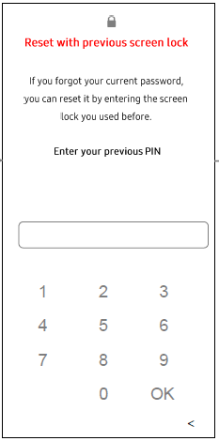
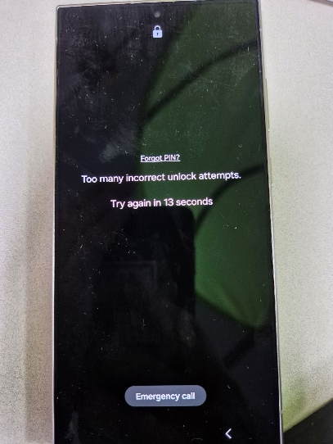
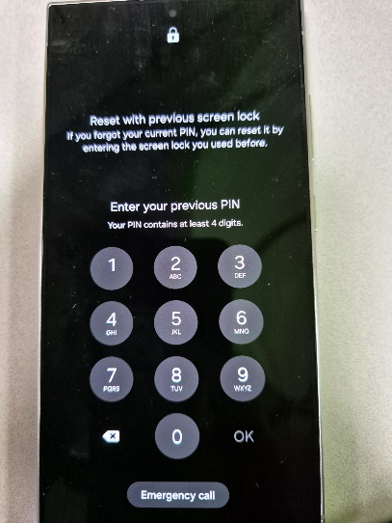
[About ‘Reset with previous screen lock’ feature] (2/6)
Updated at 2024.1.18
Q1) What is Reset with previous screen lock feature? How can I use it? Q2) I forgot 3P(PIN, Password, Pattern) information which is newly set for the screen lock. How can I unlock the device?
A:
[Affected models]
- Galaxy S24 series after SW update or Other models installed with One UI 6.1 SW version
[How to use Reset with previous screen lock feature]
- Tried and failed entering 3P(PIN, Password, Pattern) 5 times > shown Enter your previous 3P(PIN, Password, Pattern) menu > enter previous 3P(PIN, Password, Pattern)
※ This feature can only be available within 72 hours after new 3P(PIN, Password, Pattern) is set on the device
Affected models : Galaxy S24 series after SW update or Other models installed with One UI 6.1 SW version
After 5 times failed, you can see ‘Enter your previous PIN’ menu

Slide 46
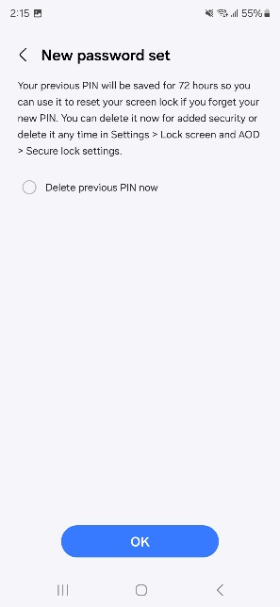
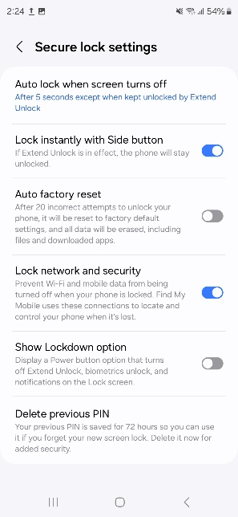
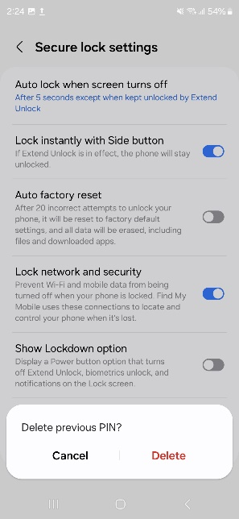
[About ‘Reset with previous screen lock’ feature] (3/6)
Updated at 2024.1.18
Q1) What is Reset with previous screen lock feature? How can I use it? Q2) I forgot 3P(PIN, Password, Pattern) information which is newly set for the screen lock. How can I unlock the device?
A:
[How to set and delete option about Delete previous 3P now and later option]
<Delete previous 3P now> : screen shown when new 3P(PIN, Password, Pattern) is set
① unselected : to save previous 3P(PIN, Password, Pattern) for 72 hours
② selected : to delete previous 3P(PIN, Password, Pattern)
<Delete previous 3P(PIN, Password, Pattern)> : Settings > Lock screen and AOD > Secure lock settings
① Delete : to delete saved previous 3P(PIN, Password, Pattern) for 72 hours
Affected models : Galaxy S24 series after SW update or Other models installed with One UI 6.1 SW version
should be unselected to use the feature
You can delete saved previous 3P in the settings menu

Slide 47
[About ‘Reset with previous screen lock’ feature] (4/6)
Updated at 2024.1.18
Q3) I forgot 3P(PIN, Password, Pattern) information which is newly set for the screen lock. And it is shown ‘Reset with previous screen lock’ menu after tried and failed 5 times but I forgot also previous 3P(PIN, Password, Pattern). How can I unlock the device? Q4) I forgot 3P(PIN, Password, Pattern) information newly set on the device and it has been passed 72 hours. How can I unlock the device?
A: You can be supported for factory reset from service center after identification. However, all user data on the device will be deleted after factory reset, so please back up all the user data on the device frequently.
※ When being supported from service center for factory reset, you may need to submit or prove your identification, confirmation of carrier subscription, some certificate for proof in case of minors, agent, etc.
Affected models : Galaxy S24 series after SW update or Other models installed with One UI 6.1 SW version

Slide 48
[About ‘Reset with previous screen lock’ feature] (5/6)
Updated at 2024.1.18
Q5: I can’t see the ‘Reset with previous screen lock’ menu on the locked screen. How should I do?
A: For your security and privacy of the personal information on the device, 3P(PIN, Password, Pattern) is kept only for 72 hours.
After 72 hours passed, the menu of ‘Reset with previous screen lock’ feature does not show anymore.
If you need to get supports for factory reset, you can contact or visit for service center supporting after checking with identification.
※ When being supported from service center for factory reset, you may need to submit or prove your identification, confirmation of carrier subscription, some certificate for proof in case of minors, agent, etc.
Affected models : Galaxy S24 series after SW update or Other models installed with One UI 6.1 SW version
After 5 times failed, you can see ‘Enter your previous PIN’ menu

Slide 49
[About ‘Reset with previous screen lock’ feature] (6/6)
Updated at 2024.1.18
Q6: Can I get a support for device unlock without deleting the user data in the service center?
A: Please understand that in the service center, it can’t unlock the device without deleting the user data.
Factory reset should be implemented to unlock the device.
Affected models : Galaxy S24 series after SW update or Other models installed with One UI 6.1 SW version

Slide 50
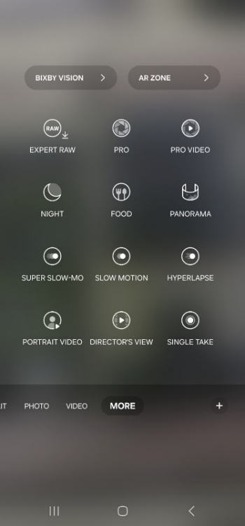
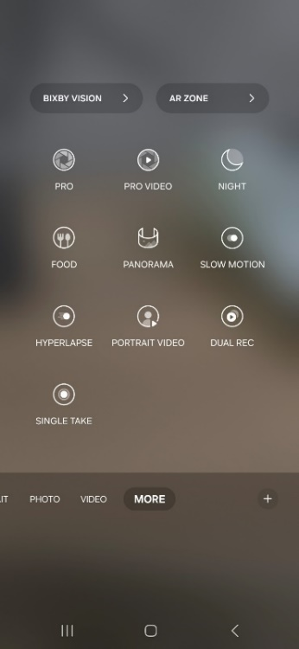
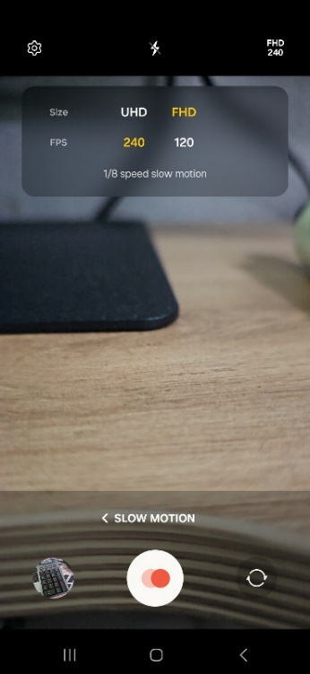
I can’t see the Super Slow-mo menu on the camera option
Updated at 2024.1.18
Q: I can’t see the Super Slow-mo menu on the camera option.
A: For better utilization of Slow motion and Super Slow-mo modes, the two modes are integrated in to Slow motion menu.
Super Slow-mo mode with shooting time(0.5s) limit is deleted, resolution and speed setting(UHD120, FHD240, FHD120) in slow motion are added to provide shooting without time limit. You can select variable option for resolution and FPS.
And you can adjust the speed(fps) of the video file with variable options in the edit menu.
※ The ‘Adjust speed’ option can be seen in the edit menu when the video is recorded in normal mode(recorded video in slow motion shows fps)
*Path for option : Camera > More > Slow motion > select resolution and FPS on the right of the top screen
*Path for edit : Gallery app > select video file > Edit > Adjust speed > select speed option to edit > Save
One UI 5.1.1
One UI 6.1
Video file
It shows in case of recording in normal video mode
Slow motion menu

Slide 51
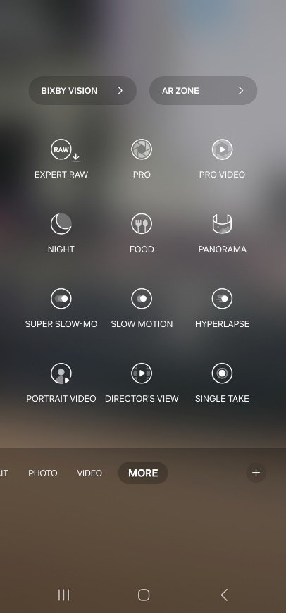
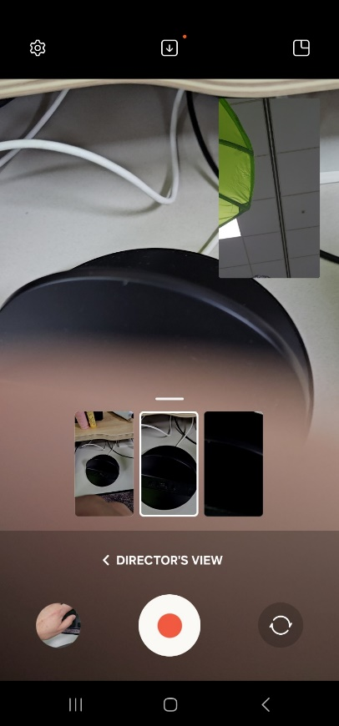
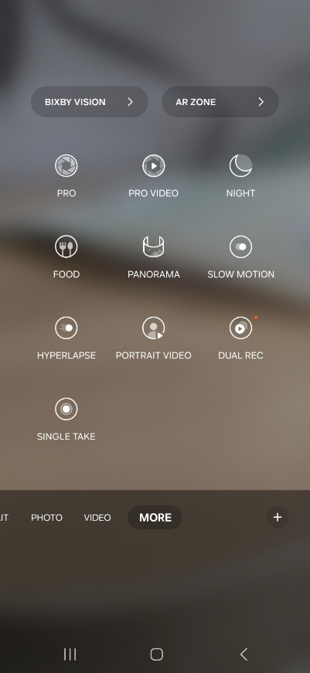
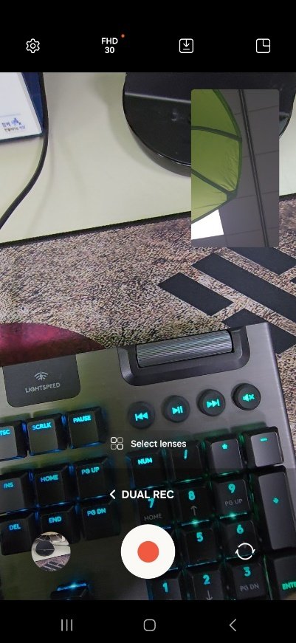
I can’t see the Director’s view menu on the camera option
Updated at 2024.1.18
Q: I can’t see the Director’s view menu on the camera option
A: For better utilization and intuitive naming of Director’s view mode, its menu name is changed to Dual recording and options are expanded.
* Option1 : FHD30fps → FHD/UHD30fps
* Option2 : Front+Rear camera → Front+Rear, Rear+Rear camera
*Path : Camera > More > Dual recording
S23 series | S24 series

Slide 52
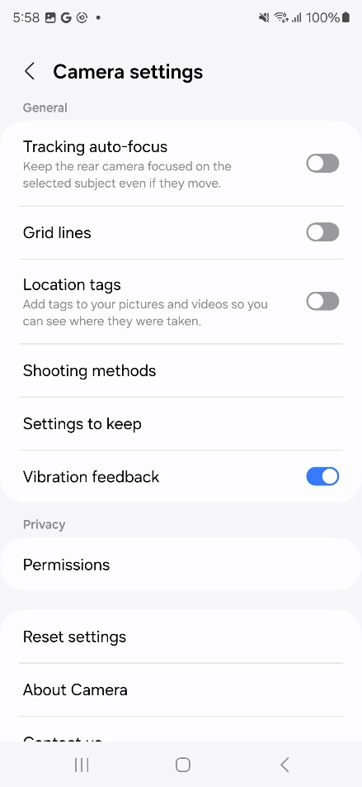
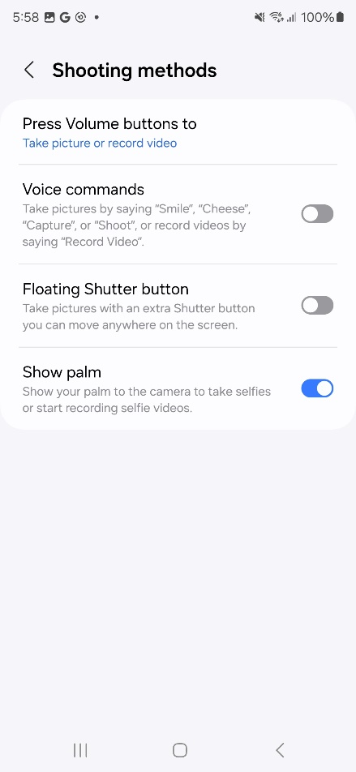
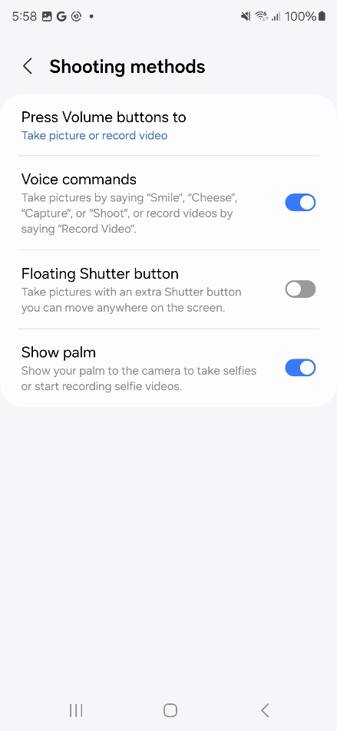
When shooting on the camera, it works voice command automatically even when I didn’t mean, and differently from previous models
Updated at 2024.1.18
Q: When shooting on the camera, it works voice command automatically even when I didn’t mean, and differently from previous models
A: Voice commands option in the camera menu is change to default On. You can turn it off in the camera settings
*Path : Camera app > settings > Shooting methods > turn off ‘Voice commands’

Slide 53
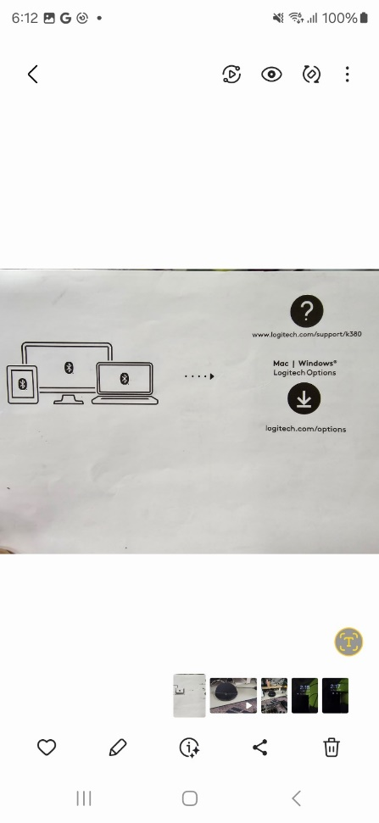
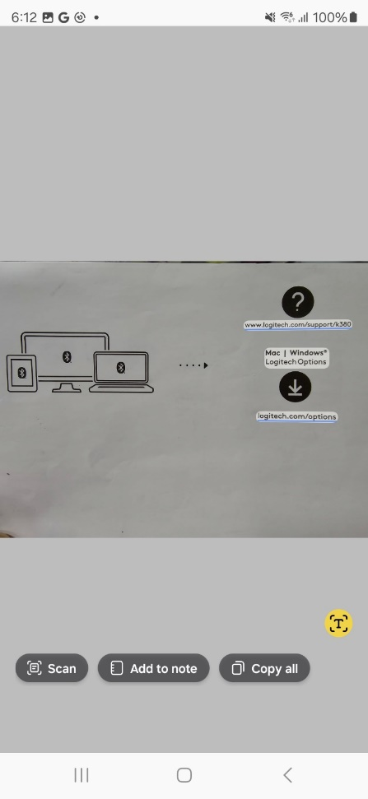
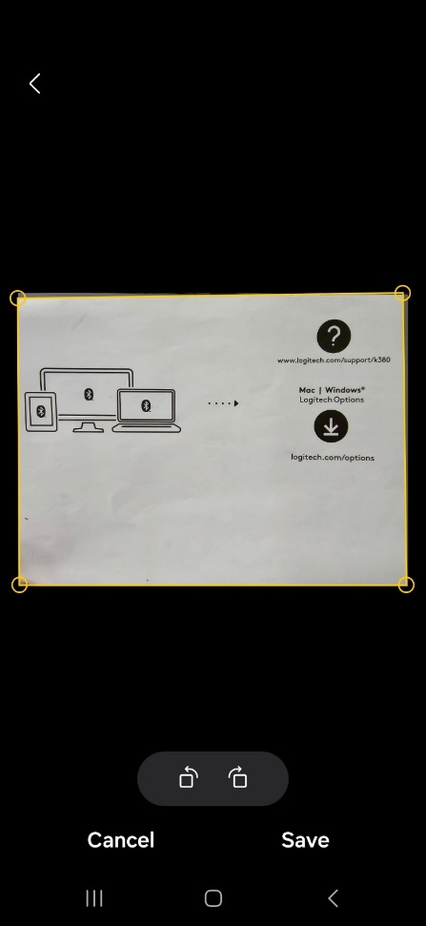
It does not sound while scanning in the Gallery
Updated at 2024.1.18
Q: It does not sound while scanning in the Gallery
A: The scanning sound is removed when working, as you may think it isn’t working. But it is not a defect. You can use it with confidence.

Slide 54
[Pause USB PD charging] What is the ‘Pause USB PD charging when gaming’ feature? (1/2)
Updated at 2024.1.18
Q: What is the ‘Pause USB PD charging when gaming’ feature?
A: ‘Pause USB PD(Power Delivery) charging when gaming’ feature is a direct power supply method to the system on the phone bypassing the battery. When the feature is enabled in a PD charger(PPS* supported TA, 25W or higher) connected on the phone during gaming, the power is supplied from a charger to the system on the phone, and physical battery charging is minimized.
It improves phenomena of the performance degradation/throttling by device heat, and possibility of lifespan deterioration caused by maintaining of continuous battery charging in high temperature situation.
It can be turned on/off directly by user option in Game Booster settings.
* Path : Gaming Hub app > More > Game Booster > turn on ‘Pause USB PD charging when gaming’
[Precondition to operate]
- When a PD charger(PPS* supported TA, 25W or higher) is connected to the device, the option is activated continuously during gaming, then you can enable the feature on the menu.
- The mode is enabled only when Battery SOC(State of Charge) ≥ 20 %
※ ‘Pause USB PD(Power Delivery) charging’ mode is a function that operates only during gaming, and is disabled and switched to battery charging state when the device operates other task than gaming such as display off(gaming not terminated)/screen switched to another one), connected with a normal Charger or not charging.
* PPS (Programmable Power Supply) : PPS is a advanced fast charging technology standard for USB-C devices that can adjust the voltage and current by feeding with maximum power depending on a device’s charging status in real time.
- PPS supported TA = PD3.0↑ TA (PD : Power Delivery)

Slide 55
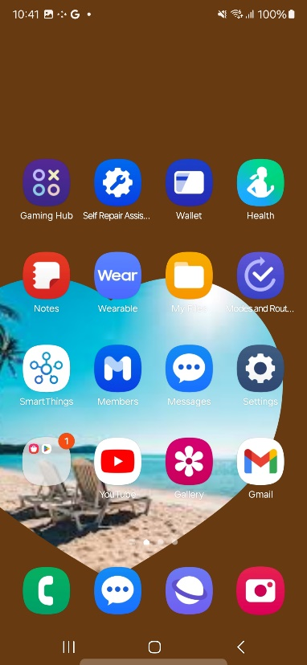
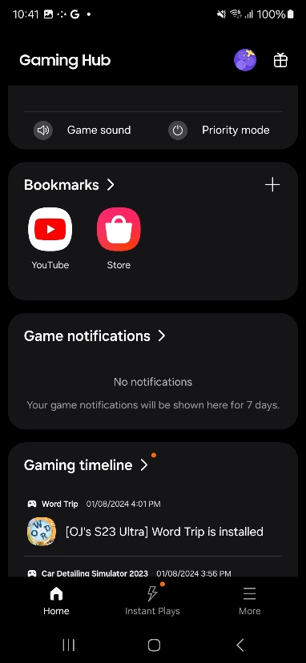
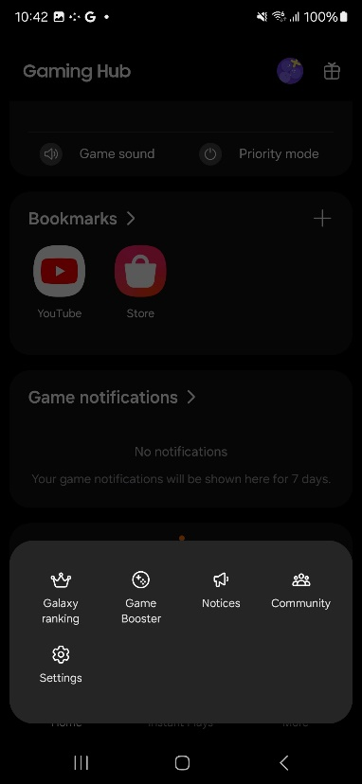
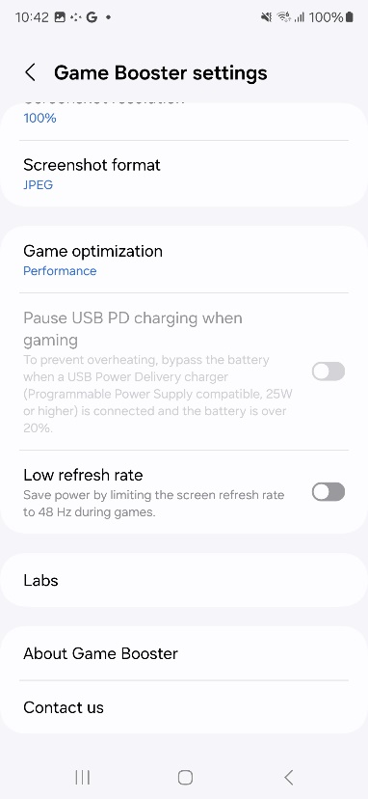
[Pause USB PD charging] What is the ‘Pause USB PD charging when gaming’ feature? (2/2)
Updated at 2024.1.18
Q: What is the ‘Pause USB PD charging when gaming’ feature?
A:
* Path : Gaming Hub app > More > Game Booster > turn on ‘Pause USB PD charging when gaming’
- Required PD charger(PPS* supported TA, 25W or higher) connection and Battery SOC(State of Charge) ≥ 20 %
When PD charger(25W or higher) is connected on the phone, the menu is activated(turned off state)
You can turn On/Off

Slide 56
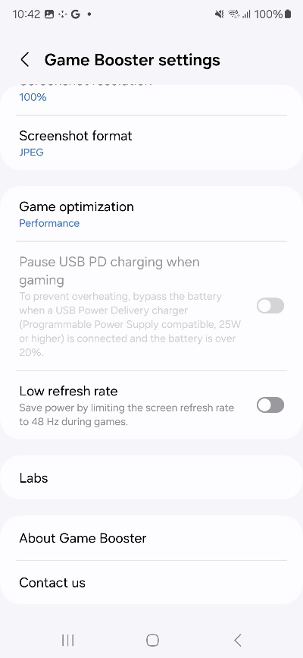
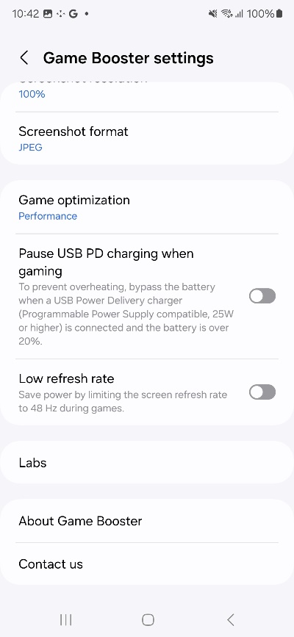
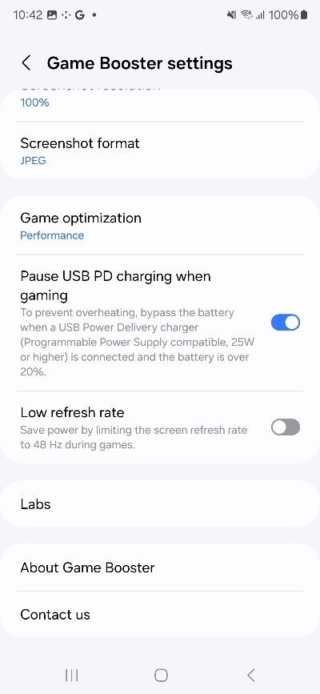
[Pause USB PD charging] The ‘Pause USB PD charging when gaming’ menu is visible, but it is not activated
Updated at 2024.1.18
Q: The ‘Pause USB PD charging when gaming’ menu is not activated
A: The ‘Pause USB PD charging when gaming’ feature is only activated when the PD charger(PPS* supported TA, 25W or higher) is connected on the phone. Then you can turn it on/off. And the battery should be over 20% to enable the feature.
* Path : Gaming Hub app > More > Game Booster > turn on ‘Pause USB PD charging when gaming’
- Required PD charger(PPS* supported TA, 25W or higher) connection and Battery SOC(State of Charge) ≥ 20 %
When PD charger(25W or higher) is connected on the phone, the menu is activated(turned off state)
Then, you can turn On/Off

Slide 57
[Pause USB PD charging] I turned on the ‘Pause USB PD charging when gaming’ feature, but the device battery has been charging. Why is that?
Updated at 2024.1.18
Q: I turned on the ‘Pause USB PD charging when gaming’ feature, but the device battery has been charging. Why is that?
A: In order to apply the ‘Pause USB PD charging when gaming’ feature, which does not charge the battery on the device and supplies the power directly to the device system, the following preconditions must be matched at the same time.
① When the game is running, and
② While the PD charger(PPS* supported TA, 25W or higher) is connected on the phone
③ The battery on the phone is over 20%
Even if the game is running, ‘Pause USB PD(Power Delivery) charging’ mode does not work in case of under operating with other tasks such as display turned off(gaming not terminated), screen switched to another one other than the games.
That is normal operation in accordance with operation condition of the ‘Pause USB PD charging when gaming’ feature in case preconditions are not met for activation.

Slide 58
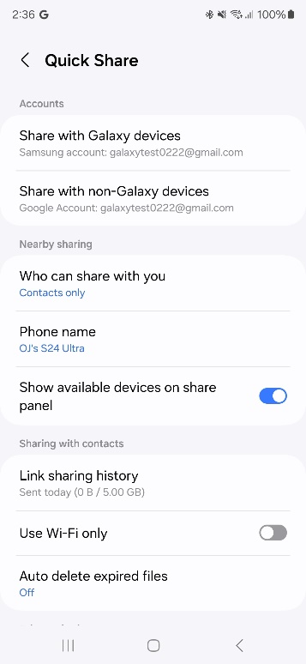
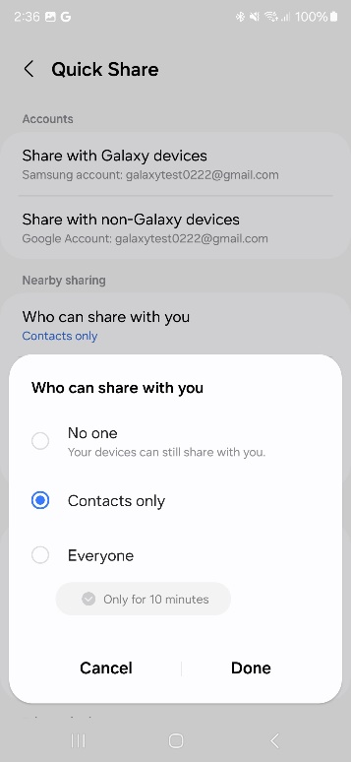
[Quick Share/Nearby Share] I can’t find ‘Nearby Share’ menu of Google / It can’t search other devices nearby
Updated at 2024.1.18
Q: I can’t find ‘Nearby Share’ menu of Google. / It can’t search other devices nearby.
A: From One UI 6.1, Quick Share and Nearby Share features are integrated. You can find it with ‘Quick Share’ in the settings.
To share to my devices or other devices nearby, both Bluetooth is turned and ‘Who can share with you’ option is selected with ‘Contacts only’ or ‘Everyone’. So, please check if the option is enabled in case of not working with Nearby sharing.
*Path : Settings > Connected devices > Quick Share
- Path1 for sharing to other devices : Settings > Connected devices > Quick Share > Who can share with you > select ‘Contacts only’ or ‘Everyone’
- Path2 for sharing to other devices : Quick panel > Quick Share > select ‘Contacts only’ or ‘Everyone’

Slide 59
[Quick Share/Nearby Share] It can’t search Nearby Share Mobile / Nearby Share PC from Quick Share PC
Updated at 2024.1.18
Q: It can’t search Nearby Share Mobile / Nearby Share PC from Quick Share PC
A: From One UI 6.1, Quick Share and Nearby Share features are integrated. However, it is not integrated for PC yet.
Currently, it does not work with searching between Quick Share PC ↔ Nearby Share Mobile, Quick Share PC ↔ Nearby Share PC.

Slide 60
It can’t search certain apps in Play Store / It does not run some apps but it is searched
Updated at 2024.1.18
Q: It can’t search certain apps in Play Store / It does not run some apps but it is searched
A: Galaxy S24 series model is 64bit dedicated device and it does not support 32bit dedicated apps, so there may not be searched or can’t be run 32bit dedicated apps. Please check if the apps are supported 64bit to the app developers.

Slide 61
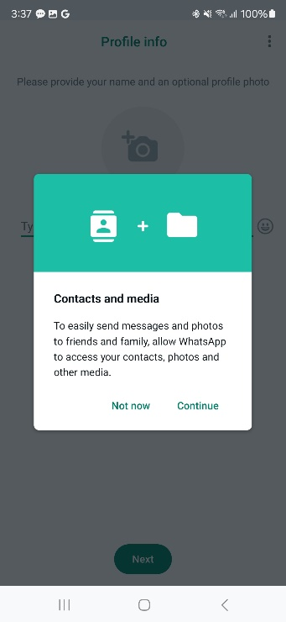
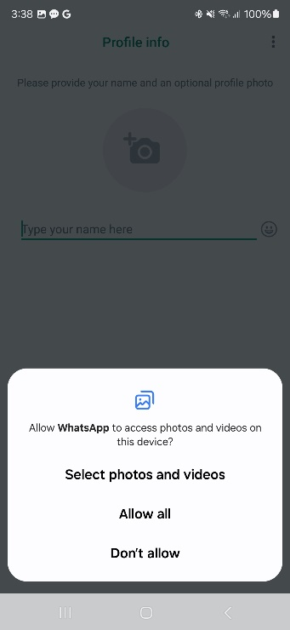
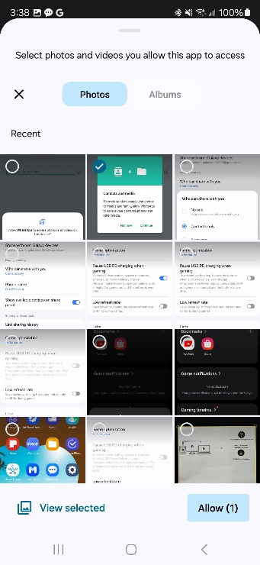
It does not show some photos in certain apps on the device. I have to select certain images and video to use the apps
Updated at 2024.1.18
Q: It does not show some photos in certain apps on the device. I have to select certain images and video to use the apps.
A: From One UI 6.0 (Android U OS), the ‘Select photos and videos’ permission is newly added to allow for users to access only photos and videos designated by users in each app for security enhancement.
① To set the app to access all photos and videos : It comes from that Photos and videos permission is set to ‘Ask every time’, so you can set it ‘Always allow all’.
* Path : Settings > Apps > select app > Permissions > Photos and videos > set to Always allow all
② To set the app to access designated photos and videos : You can set ‘Select photos and videos’ option through each app settings for permissions. (When attaching photos or entering the apps at the first time, you can set the options)

Slide 62
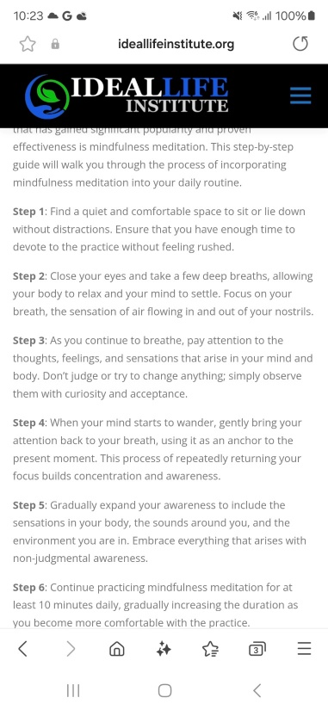
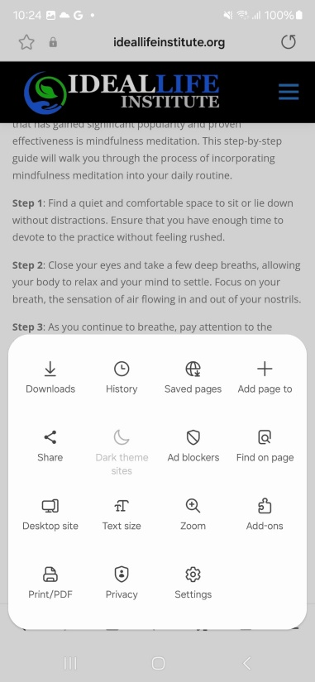
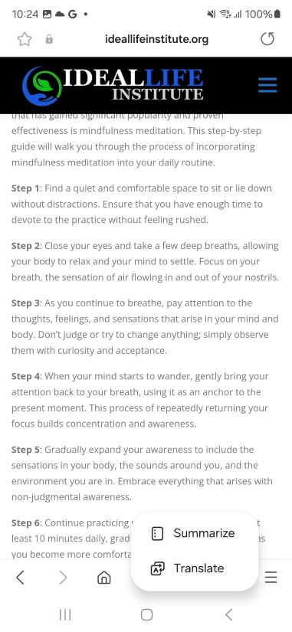
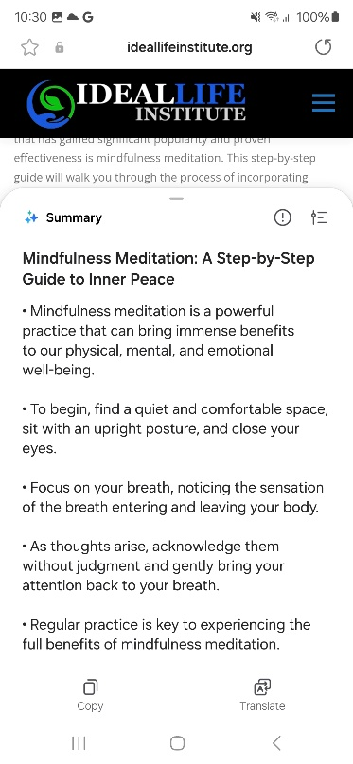
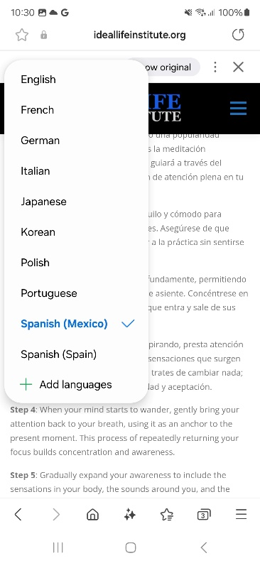
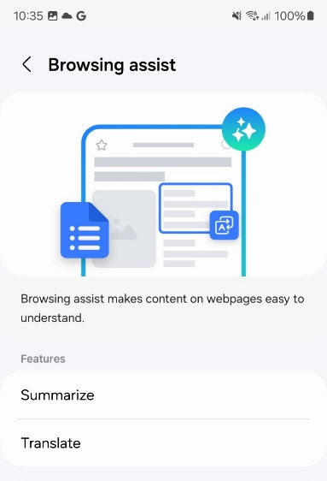
[Advanced Intelligence][Samsung Internet] How to use Browsing assist - Summarize or translate texts on the webpages
Updated at 2024.1.18
Q: How to use Browsing assist - Summarize or translate texts on the webpages?
A: Samsung Internet newly supports summarizing and translating current webpage, and also highlighting the main contents.
You can enable the function in the Samsung Internet setting on the device.
*Path for set(①) : Samsung Internet > Tools(≡) > Settings > Browsing assist > turn on ‘Summarize’ or download language packs for offline translation
*Path for use(②) : Samsung Internet > Browsing assist on the bottom tab > select ‘Summarize’ or ‘Translate’ to turn on or use
- Supported languages for Summary(TBU) : same languages(39) as Auto format in Samsung Notes
. text limitation : 8,000(Global), 4,300(Korean, Chinese, Japanese)
- Supported languages for Translation(TBU) : 13 languages(17 Locale)
※ Note : Translation output and its accuracy may vary every time
select language to translate
2
1
set for each
2
1
※ Some of specific option or availability may vary by model code, region or country, carrier and SW version

Slide 63
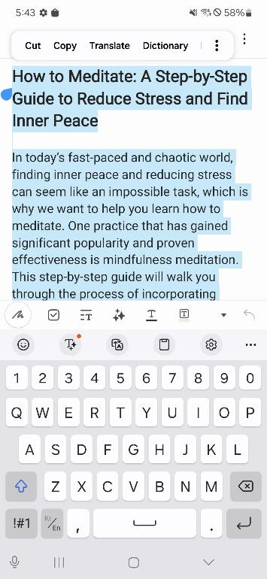
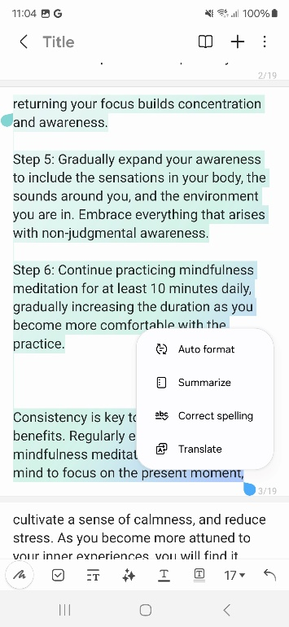
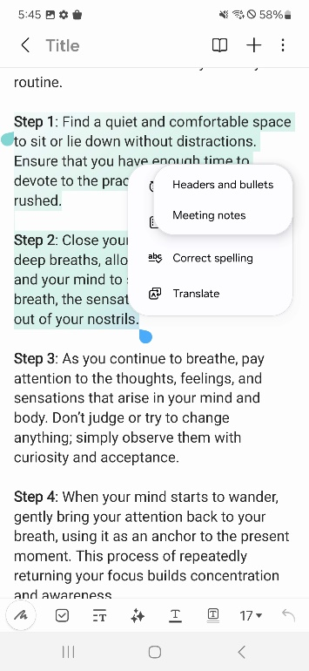
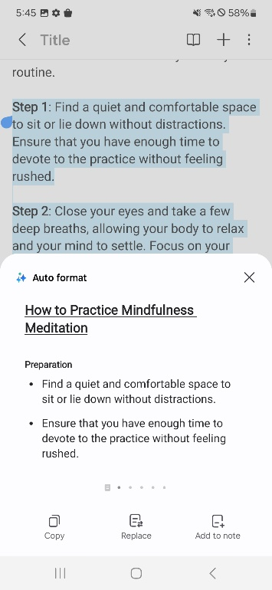
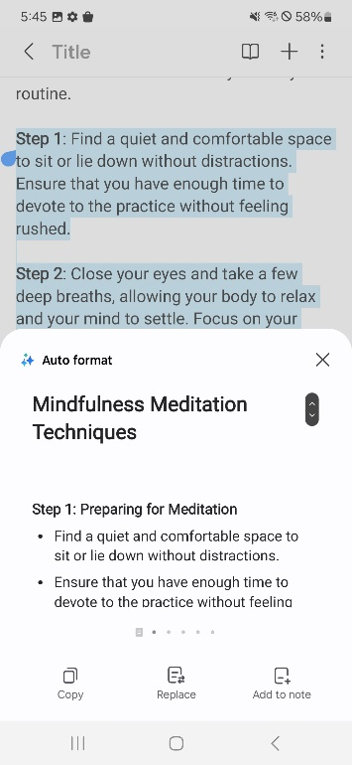
[Advanced Intelligence][Samsung Notes] How to use Note assist - Auto format
Updated at 2024.1.18
Q: How to use Note assist - Auto format?
A: It organizes text content of Notes automatically into a arranged paragraph format(Headers and bullets or Meeting notes).
You can select text content and then select the format to organize through AI menu on the bottom tool area.
*Path : Samsung Notes > Note assist > Auto format > select ①‘Headers and bullets’ or ②‘Meeting notes’
- Supported languages for Auto format, Summarize, Generate Cover (TBU) : English, Portuguese, Spanish, French, Korean, German, Italian, Chinese(Traditional/Simplified),
Japanese, Russian, Arabic, Hindi, Polish, Thai, Vietnamese, Indonesian, Turkish, Rumanian, Dutch, Swedish, Czech, Danish, Finnish, Hungarian, Ukrainian, Hebrew,
Greek, Serbian, Bulgarian, Croatian, Norwegian, Slovak, Lithuanian, Slovenian, Latvian, Estonian, Bengali, Swahili(Africa)
1
2

Slide 64
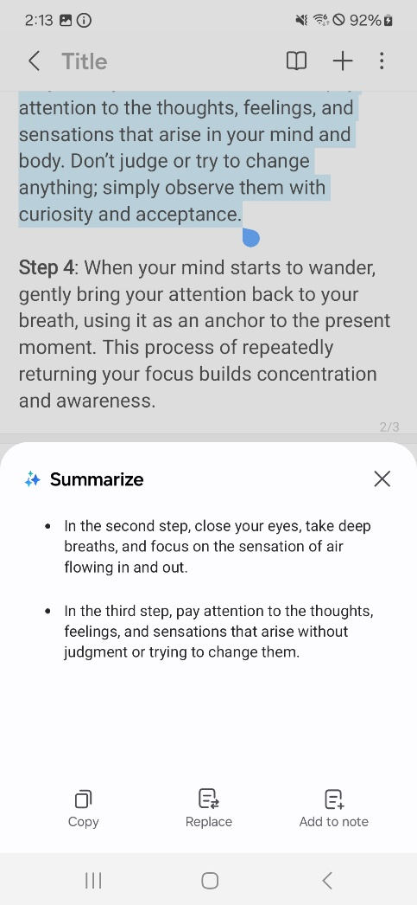
[Advanced Intelligence][Samsung Notes] How to use Note assist - Summarize
Updated at 2024.1.18
Q: How to use Note assist - Summarize?
A: It provides summarized context of the note’s content.
*Path : Samsung Notes > Note assist > Summarize

Slide 65
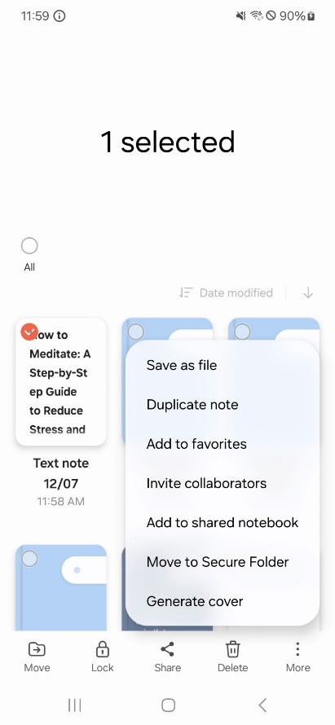
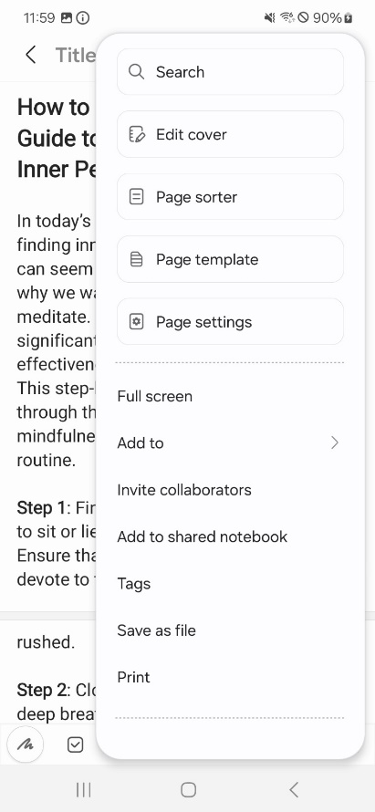
[Advanced Intelligence][Samsung Notes] How to use Note assist - Generate cover
Updated at 2024.1.18
Q: How to use Note assist - Generate cover?
A: It provides automatically generated note cover based on contents in the note, and you can set or edit the cover style/color by manual.
*Path :
① Samsung Notes > press and hold to select Notes file > More on the bottom > Generate cover
② Samsung Notes > tab to enter Notes file > More options on the top > Edit cover > turn On > Generate cover
③ Samsung Notes > select Notes > tab on Title area > Generate cover
Generate cover
turn On/Off option
1
2
3

Slide 66
[Advanced Intelligence][Samsung Notes] How to use View recent memos as text
Updated at 2024.1.18
Q: How to use View recent memos as text?
A: It provides view with lists of recent screen off memos as text on the Notes.
*Path : Samsung Notes > Navigation drawer > Folders > Screen off memos > View recent memos as text
Affected models : S24 Ultra only

Slide 67
[Advanced Intelligence][Voice Recorder] How to use Transcript assist - Speech to text and Transformation
Updated at 2024.1.18
Q: How to use Transcript assist - Speech to text and Transformation
A: You can make speech to text file with recorded file and also make transformed file into selected other language. And you can transform the text to another language. It is not a translation of recording language but a transformation of recordings from recorded language to others.
*Path: Voice Recorder > select recording files(one or mores) > Transcribe on the bottom menu > select language to transform > tab ‘Transcribe’
- tab the transcribed file to see whole texts
- tab more options to transform to another language
- Supported languages for Transcription, Translation (TBU) : English(US/Great Britain/India),
Portuguese(Brazil), Spanish(Spain/Mexico/US), French(France), Korean, German, Italian,
Chinese(Simplified), Japanese, Hindi, Polish, Thai, Vietnamese
1
select to transcribe to another language
① press and hold or ② tab the recording files to select, then tab Transcribe
2
※ Some of specific option or availability may vary by model code, region or country, carrier and SW version

Slide 68
[Advanced Intelligence][Voice Recorder] How to use Transcript assist - Speech to text and Summary
Updated at 2024.1.18
Q: How to use Transcript assist - Speech to text and Summary
A: You can make speech to text file with recorded file and it shows text transcript and summarize it.
*Path: Voice Recorder > select recording files(one or mores) > Transcribe on the bottom menu > tab ‘Transcribe’ to see the whole transcript, and tab ‘Summary’ to see the summary
- Supported languages for Summary (TBU) : same languages(39) as Auto format in Samsung Notes
1
① press and hold or ② tab the recording files to select, then tab Transcribe
2

Slide 69
[Advanced Intelligence][Phone app - Call] How to use Phone app - Live translate during call (1/2)
Updated at 2024.1.18
Q: How to use Phone app - Live translate during call?
A: When answering the call, you can select Live translate or Text call, so you can get real-time translation into selected language or you can answer call without saying a word and see in a text chat on the Samsung Phone app.
※ For text call, Bixby will ask the caller and read the scripts to the caller.
*Path :
For set : ① Samsung Phone app > More options > Settings > Live translate or Text call > turn On and set the language Me and Other person
② (For Live translate) Settings > Advanced features > Advanced intelligence > Phone > turn On ‘Live translate’
For use : incoming call > tab Call assist > tab Live translate or Text call > you can change the language option
※ Note : Translation output and its accuracy may vary every time
- Supports(TBU) : 13 languages(17 Locale)
For settings
When calling
※ Some of specific option or availability may vary by model code, region or country, carrier and SW version

Slide 70
[Advanced Intelligence][Phone app - Call] How to use Phone app - Live translate during call (2/2)
Updated at 2024.1.18
Q: How to use Phone app - Live translate during call?
A: You can mute my voice or the other person’s voice to block original language voice but to send a translation of what I say or to hear a translation of what the other person says through the menu. To unblock, you can turn off the features.
And you also able to preset language and voice for each person with specific phone number or contacts.
*Path for
① Mute original voice : Settings > Advanced features > Advanced intelligence > Phone > turn on ‘Mute my voice’ or ‘Mute other person’s voice
② language and voice presets : Settings > Advanced features > Advanced intelligence > Phone > Language and voice presets for each person
① Mute original voice
② language and voice presets
To block my original language voice for the other person to hear a translation only
To block the other person’s original language voice for me to hear a translation only
※ Some of specific option or availability may vary by model code, region or country, carrier and SW version

Slide 71
[Advanced Intelligence][Interpreter] How to use Interpreter app?
Updated at 2024.1.18
Q: How to use Interpreter app?
A: You can set and use live translation of spoken conversations through Interpreter app, either as text or voice reading it aloud.
*Path :
① (For set) Settings > Advanced features > Advanced intelligence > Interpreter
② (For use) Quick Panel > ‘Interpreter’ (swipe left to see it on the next screen) > set the language option to translate > tab Talk button
※ Note : Translation output and its accuracy may vary every time
- Supports(TBU) : 13 languages(17 Locale)
① Set for Interpreter
② How to use
tab ‘More options’ to go settings menu
※ Some of specific option or availability may vary by model code, region or country, carrier and SW version

Slide 72
[Advanced Intelligence][Samsung Keyboard] How to use Writing assist - Writing style/Spelling and grammar
Updated at 2024.1.18
Q: How to use Writing assist - Writing style/Spelling and grammar?
A: It provides writing style function to change the tone and suggested spelling and grammar for correction
*Path : Samsung Keyboard > write a text > tab Writing assist > enable the function > select Writing style/Spelling and grammar > select Copy or Insert (Writing style option : Professional/Casual/#social/Polite/Emojify)
- Supported languages for Writing style, Spelling and grammar(TBU) : English, Portuguese, Spanish, French, Korean, German, Italian, Chinese(Traditional/Simplified),
Japanese, Russian, Arabic, Hindi, Polish, Thai, Vietnamese, Indonesian, Turkish, Rumanian, Dutch, Swedish, Czech, Danish, Finnish, Hungarian, Ukrainian, Hebrew,
Greek, Serbian, Bulgarian, Croatian, Norwegian, Slovak, Lithuanian, Slovenian, Latvian, Estonian, Bengali, Swahili(Africa)
- Supported apps for Writing style(Tone Change), Spelling and grammar : All apps with Samsung Keyboard
swipe up to select more
※ Some of specific option or availability may vary by model code, region or country, carrier and SW version

Slide 73
[Advanced Intelligence][Samsung Keyboard] How to use Writing assist - Chat translation (1/2)
Updated at 2024.1.18
Q: How to use Writing assist - Chat translation?
A: It provides chat and text translation into selected language on the apps that support the function. Translations are processed on your phone, so you have to download language packs to translate you want on the device.
*Path for set : Settings > Advanced features > Advanced intelligence > Samsung keyboard > Chat translation > turn on and download language packs for translation
[Set for Chat translation]
- Supports(TBU) : 13 languages(17 Locale)
- Supported apps for Chat translation : Samsung Messages, Google Messages, KakaoTalk,
WhatsApp, Instagram(DM), Google Chat, Signal, Line Messenger, Tango
※ Note : Translation output and its accuracy may vary every time
download language packs to use for translation
※ Some of specific option or availability may vary by model code, region or country, carrier and SW version

Slide 74
[Advanced Intelligence][Samsung Keyboard] How to use Writing assist - Chat translation (2/2)
Updated at 2024.1.18
Q: How to use Writing assist - Chat translation?
A:
*Path for use : Apps(Messages or chat app) that support the function > tab Writing assist > tab ‘Chat translation’ > tab turn on both the function and the function for the app on the popup > select language to translate on the language option popup of the top > type a message
[Use with Chat translation]
type and press enter to add continuous input, and press ‘Send’ when finishing input and sending the message
※ Some of specific option or availability may vary by model code, region or country, carrier and SW version

Slide 75
[Advanced Intelligence][Wallpaper and style] How to use Generative wallpaper
Updated at 2024.1.18
Q: How to use Generative wallpaper?
A: You can create your own wallpaper along with selected items from recommended wallpaper contents and style categories.
* Path : Settings > Wallpaper and style > Change wallpapers > Creative > Generative > select category and item(bold text) to change > tab Generate
select generated wallpaper

Slide 76
[Advanced Intelligence][Wallpaper and style] How to use Frame/Effect?
Updated at 2024.1.18
Q: How to use Frame/Effect?
A: You can apply various frame or color effect to make personalized and customized with photos of Gallery for wallpapers.
*Path : Settings > Wallpaper and style > Change wallpapers > Gallery > select photo > select where to apply > tab Frame or Effect > swipe left/right to choose the option > tab ‘Done’
swipe left/right to select mode

Slide 77
[Advanced Intelligence][Wallpaper and style] How to use Photo ambient wallpaper?
Updated at 2024.1.18
Q: How to use Photo ambient wallpaper?
A: You can set your own photo as a ambient wallpaper for lock screen based on the time and weather in real time. You can use the photos stored in the Gallery app, it changes the weather based on the default location in the Weather app. This a labs feature, so the weather can be reflected only some weather conditions.
*Path for set : Settings > Advanced features > Labs > Photo ambient wallpaper > turn On the feature
- If the Weather app and the location is not set or turned on, you need to set and enable it to use the feature
*Path for use : press and hold empty area in home screen > Wallpaper and style > Change wallpapers > Creative
※ Time-of-day changes don’t always show current conditions precisely, and results may take time to show. Nighttime and indoor photos might not look right.
enable to use and see the feature | select a photo to set for use
select photo to use
tab to see a preview
and tab ‘Done’ to apply

Slide 78
[Lock screen and AOD] How to use AOD background set
Updated at 2024.1.18
Q: How to use AOD(Always On Display) background set?
A: You can set or change background style to be shown on AOD screen that is set as your lock screen wallpaper.
*Path : Settings > Lock screen and AOD > Always On Display > tab to enable ‘Show Lock screen wallpaper’
- Show Lock screen wallpaper / Erase background(function to erase background from animal/human images to emphasize the object)

Slide 79
[Lock screen and AOD] How to add Widgets on Lock screen and AOD?
Updated at 2024.1.18
Q: How to add Widgets on Lock screen and AOD?
A: You can add some of Widgets to show concise information on the Lock screen and AOD.
*Path : press and hold any empty area on the Lock screen > tab + Widgets > add one or two Widgets and type to add > tab ‘Done’

Slide 80
[Lock screen and AOD] I can’t find Auto brightness and manual adjustable bar for brightness on AOD setting
Updated at 2024.1.18
Q: I can’t find Auto brightness and manual adjustable bar for brightness on AOD setting
A: For better AOD(Always On Display) experience, some of AOD options are changed. The Auto brightness switch and adjustable bar for brightness by manual options are removed and the brightness is automatically adjusted. The brightness level is optimized and much improved to recognize more vividly. And AOD display when to show option is newly added with ‘Auto’ option.
One UI 6.0 or earlier version | One UI 6.1 or later version
double tap to show adjustable bar on AOD
newly added
auto brightness switch and manual adjustable bar removed

Slide 81
[Advanced Intelligence][Gallery-Photo Editor] How to use Generative edit (1/2)
Updated at 2024.1.18
Q: How to use Generative edit?
A: You can reimagine images from the photos saved in the device by moving, removing, resizing the objects such as people, pets, things on it.
It generates new background to fill in the missing pieces and space after adjusting the angle of image.
*Path1 : select photo in Gallery > Edit > Generative edit > tab ‘OK’ to turn on > draw or press and hold the objects to edit > select action to move(press and hold)/resize/remove it > tab ‘Generative’ > save as copy
moving the object and resizing it to be smaller
draw or press and hold to select the objects
select action to perform
(drag and drop for moving, return, remove, adjust size)

Slide 82
[Advanced Intelligence][Gallery-Photo Editor] How to use Generative edit (2/2)
Updated at 2024.1.18
Q: How to use Generative edit?
A:
※ Photo editor’s Generative Edit feature requires a Wi-Fi connection or mobile data depending on your carrier, you may be charged for using this feature with mobile data. Any images you edit with generative edit will be collected and processed.
*Path2 : select photo in Gallery > Edit > Generative edit > drag left/right to adjust straighten > tab ‘Generative’ > save as copy

Slide 83
[Gallery-Photo Editor] How to use increase Resolution?
Updated at 2024.1.18
Q: How to use increase Resolution?
A: You can increase resolution the photos you selected in the Gallery app.
*Path : Gallery > select photo to edit > Edit > try any edit action to perform to Save > tab Save or Save as copy in more options > select Increase resolution option > Save
showing popup in case of selecting ‘Save’ option

Slide 84
[Gallery] How to use search in Gallery
Updated at 2024.1.18
Q: How to use search in Gallery?
A: You can search with natural language by entering atmosphere of the photo or the phrase that describes the object, or you can choose suggested category with more specific and broad items on the screen from below search bar when entering a word.
It is expanded to the ‘People and Pets’ category, you can quickly search and find contents in the Gallery related to the described things.
*Path : Gallery > Search > enter on the search bar with described words or select suggested/categorized item
suggested items
categorized items

Slide 85
[Gallery] How to use Smart capture?
Updated at 2024.1.18
Q: How to use Smart capture?
A: When you capture image, relevant recommended useful actions are provided. For coupon image, it provides add to Samsung Wallet function to register and save automatically so that you can keep and manage to use it later.
And captured image can be categorized based on its contents in the Album (coupon, schedule, boarding pass, shopping, place, etc.). The keyword information extracted when capturing is stored with screenshots to facilitate it in the Gallery.
Screenshot
Samsung Wallet
highlight texts
※ Some of specific option or availability may vary by model code, region or country, carrier and SW version
recommended useful actions

Slide 86
[Gallery] How to use Edit Suggestion?
Updated at 2024.1.18
Q: How to use Edit Suggestion?
A: It provides suggested and applicable edit option for photos in Gallery app. You can select and tab to apply the edit effect on the screen of the photo. Suggested options may vary based on photo contents. And some features(Long exposure, 24hr time-lapse, Highlights) will be shown when the phone is charging after a certain period of time since taking a photo.
*Path : Gallery app > select a photo > tab ‘Details’ icon or swipe up to see Details > select the edit option
- Options : Portrait effect, Erase reflections/shadows, Remove moire, Background blur, Long exposure, Remaster, Colorize, Highlights, Super slow-mo, Star trails, 24hr time-lapse
tab ‘Details’ or swipe up to see Details of the photo
※ Some of specific option or availability may vary by model code, region or country, carrier and SW version

Slide 87
[Circle to Search with Google] How to use Circle to Search with Google?
Updated at 2024.1.18
Q: How to use Circle to Search with Google?
A: You can search what you see by tapping, scribbling or drawing circle any areas on the screen and get further information for the images or text about it. When you tap or scribble the text, it automatically provides search result and you can adjust selected range, and also you can select ‘Copy’ or ‘Translate’ for further action.
*Path for set : Settings > Display > Navigation bar > turn on ‘Circle to Search’
*Path for use : press and hold home button on the navigation bar > circle or tap anywhere to search
- Supports : 7 languages(English, Hindi, Indonesian, Japanese,
Korean, Portuguese(Brazil), Spanish(Mexico)
- Supported in : over 120 countries and territories
turn on to use Circle to Search
for button type
press and hold home area to run Circle to Search
for swipe gestures type
※ Accuracy and search results may vary depending on the type and shape of the object in the image because of similarity, relevance, identification, the nature of the search algorithm

Slide 88
[Navigation bar] What is changing with Swipe gestures? (1/2)
Updated at 2024.1.18
Q1) It is changed to Navigation button type option, and it does not work swipe up from both sides area of the bottom on the screen Q2) I can’t find Swipe from bottom option in Swipe gestures of Navigation type setting
A: From One UI 6.1 version, Navigation bar user experience is changed with more simplified options and new menus. Gesture options related to ‘Swipe up from bottom’ are more simplified and menu paths for some options are changed.
① (removed) ‘Swipe from bottom’ option in Swipe gestures > More options → (remained) Swipe from sides and bottom
② (removed) ‘Gesture hint’, ‘Show button to hide keyboard’ option in Swipe gestures
③ (added) Google Assistant app switch option in the main screen of Navigation bar and changed from default Off → On
④ newly (added) ‘Circle to Search’ switch option
*Path : Settings > Display > Navigation bar > Swipe gestures
One UI 6.0 or earlier version | One UI 6.1 or later version
removed option
menu added on the main screen and changed to Default On
newly added
menu path and default option changed

Slide 89
[Navigation bar] What is changing with Swipe gestures? (2/2)
Updated at 2024.1.18
Q1) It is changed to Navigation button type option, and it does not work swipe up from both sides area of the bottom on the screen Q2) I can’t find Swipe from bottom option in Swipe gestures of Navigation type setting
A:
For Google Assistant, you can swipe up from either side of the both bottom corners.

Slide 90
After attaching the 3rd party protective film, the screen appears blurry and the visibility seems to be reduced
Updated at 2024.1.18
Q: After attaching the 3rd party protective film, the screen appears blurry and the visibility seems to be reduced
A: The display is composed of various parts such as protective glass, display panel, sensor, tapes, and mechanical parts, and Galaxy S24 series display has applied improved screen component (Window coating and AR protective film) that have much vivid visibility on the device.
So, with attaching the 3rd party protective film, the screen may have lower visibility or more blurry display.
It is not recommended attaching with 3rd party protective film on the screen of the Galaxy device.

Slide 91
It looks the S-Pen is a little bit popping up from the hole of the device when inserting it
Updated at 2024.1.18
Q: It looks the S-Pen is a little bit popping up from the hole of the device when inserting it.
A: The S-Pen of the Galaxy S24 Ultra has improved structure and usability for easy inserting/removing while maintaining robustness.
When inserting the S-pen of the Galaxy S24 Ultra, the end tip looks protruded slightly.
When using initially, you may feel a slight protrusion, but it is not a defect. So please be assured that this is a design considering the usability and stability of high-precision products.
The product is released through thorough and strict quality control and testing.
※ The S-Pen is a precisely designed component that considers external shocks, so there is no problem with normal use in usual environments, but excessive operation or shock repeatedly can shorten the lifespan and breakage.

Slide 92
It looks the S-Pen is a little bit tilted in the hole of the device when inserting it
Updated at 2024.1.18
Q: It looks the S-Pen is a little bit tilted in the hole of the device when inserting it
A: The S-Pen structure and module of the Galaxy S24 Ultra the same as before, but unlike the previous model, the Galaxy S24 Ultra model is matte and brighter, so it makes more remarkable than other models.
The S-Pen end tip has a gap inside which is design for pop up/down motion, so there may feel a little flow, but there is no unusual point with appearance in the S-Pen itself.
When inserting the S-Pen on the device, it can be forced to one side because of the structure that is locked.
So please be assured that this is a design considering the usability and stability of high-precision products.
The product is released through thorough and strict quality control and testing.
※ The S-Pen is a precisely designed component that considers external shocks, so there is no problem with normal use in usual environments, but excessive operation or shock repeatedly can shorten the lifespan and breakage.

Slide 93
It seems there’s fine dust inside the camera of Galaxy device (1/2)
Updated at 2024.1.18
Q1: It seems there’s fine dust inside the camera of Galaxy device.
A: All Samsung phones are managed and manufactured through strict quality control measures including foreign matter prevention activities and rigorous inspection to ensure that they meet our quality controls standards.
However, despite our best efforts during the manufacturing process, there may occasionally be instances where fine dust inside within our acceptable range and this does not affect the performance of the camera.
And if there are no substances or particles seen both when taking a picture or reviewing the picture taken, and it is not considered a product defect. So you can use it with confidence.
<For your reference>
When taking a picture, the image passes through the lens and shapes of the image are shown on the image sensor.
Consequently, the fine dust located on the lens or window, which is relatively far away from the image sensor, may not appear in the taken picture. Conversely, if there is dust on the image sensor, it may appear on the taken picture, and that may be judged to be a defect.

Slide 94
It seems there is smell something sort of like burning on the S pen of the device
Updated at 2024.1.18
Q: It seems there is smell something sort of like burning on the S pen of the device
A: There may have smell the new product’s own plastic or rubber temporarily. That is caused by temporary phenomenon and it gradually disappears over time. You can use it with confidence.
※ Smell case of new products
For example) new car seats, rubber in new shoes, leather of new bags may have smell at the time of manufacturing and it disappears as time goes by.
S Pen meets Samsung’s strict quality standards related to harmful substances and safety, so you can be secure and relieved while using it.

Slide 95
It can’t unlock the lock screen even when swiping the screen
Updated at 2024.1.18
Q: It can’t unlock the lock screen even when swiping the screen
A: Galaxy S24 series has newly added feature with ‘Show Lock screen wallpaper’ (Default : On) which is set to show the wallpaper of the lock screen in AOD screen. If it is set to ‘Always’ option of When to show, the wallpaper can be shown always in AOD screen.
So, this(wallpaper is set in both lock screen and AOD screen) may be considered AOD screen as a lock screen, but it is AOD screen.
If you don’t want to show the wallpaper in AOD screen, you can turn off the function on the settings.
*Path : Settings > Lock screen and AOD > Always On Display > turn Off ‘Show Lock screen wallpaper’ (Default : On)

Slide 96
Q1) When I set to turn on the AOD, it show lock screen wallpaper Q2) Even I set to turn on the AOD, AOD screen does not appear
Updated at 2024.1.18
Q1) When I set to turn on the AOD, it show lock screen wallpaper Q2) Even I set to turn on the AOD, AOD screen does not appear
A: Galaxy S24 series has newly added feature with ‘Show Lock screen wallpaper’ (Default : On) which is set to show the wallpaper of the lock screen in AOD screen. If it is set to ‘Always’ option of When to show, the wallpaper can be shown always in AOD screen.
So, this(wallpaper is set in both lock screen and AOD screen) may be considered AOD screen as a lock screen, but it is AOD screen.
If you don’t want to show the wallpaper in AOD screen, you can turn off the function on the settings.
*Path : Settings > Lock screen and AOD > Always On Display > turn Off ‘Show Lock screen wallpaper’ (Default : On)
- If you would set the wallpaper in AOD screen but not to show always, then you can keep Show Lock screen wallpaper to On and set the When to show to ‘Tap to show’

Slide 97
Revision History: This version replaces all previous versions
Date | Version | Comments
2024.1.18 | V1.0 | HQ MX Quality Administration Group made initial version : - Page 4 : specification for reference - Page 5~94 : Q&A pages
2024.1.18 | V1.1 | HQ MX Quality Administration Group updated : - Page 72 : changed images for icon of Writing assist ( → ) on image #1,2 - Page 73 : changed image for icon of Writing assist on image #2 - Page 95~96 : added pages regarding AOD screen related Q&As

